Slide 1
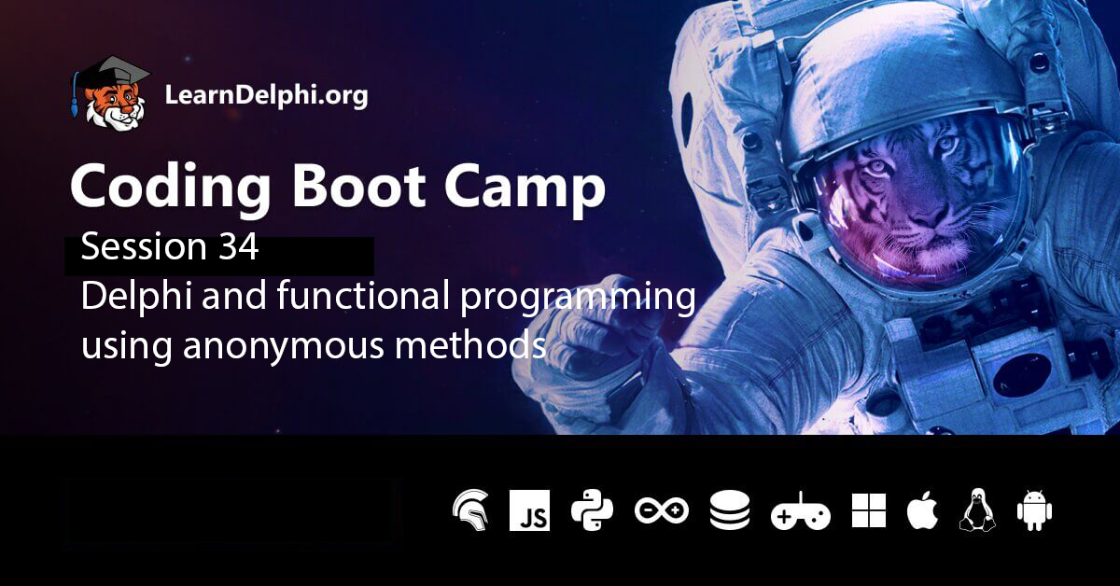

Slide 2


Coding Boot Camp 2022
How to Program Effectively in Delphi for AS/A Level Computer Science
By Kevin R Bond
Available in both print and pdf formats from
https://www.educational-computing.net
Main site for information
http://www.educational-computing.co.uk
Length =1200 pages.
Suitable for all levels from beginner to advanced developer

Slide 3
Overview
Background
Concepts - Function, Function type, Function application,
Partial function application, Function composition, Lambda calculus
Higher-order functions – Map, Reduce, Filter
Closure.

Slide 4
Programming paradigms
LOOSELY SPEAKING THIS REFERS TO THE EXECUTION MODEL AND HOW THE CODE IS ORGANISED.
THERE ARE TWO MAIN PARADIGMS:
IMPERATIVE
DECLARATIVE
Execution model and organisation closely follows the way the underlying machine operates – one statement at time, statements executed in sequence, statements/operations change the state of variables/objects, execution has some effect on a memory store.
In declarative programming the programmer supplies the what (what information is required) and the how is left to the language to figure out. Execution and organisation doesn’t follow the way the underlying machine operates. This reduces the brain-to-code distance by supporting programming at a very high level.

Slide 5
Programming paradigms
Imperative – the world is sequential, time marches forward because of the 2nd Law of Thermodynamics ΔS ≥ 0
Procedural – Pascal, mutable state
Object-oriented – Object Pascal, encapsulated mutable state
Event-driven – Delphi
Notes:
Integral Solutions Ltd (ISL) – Poplog = POP 11, Prolog
Clementine (Predictive Analytics Capabilities) sold to SPSS Inc., which sold to IBM Clementine is now IBM SPSS Modeler Professional A demo. It illustrates a class of applications of AI in a business context.

Slide 6
Programming paradigms
Declarative – time independent
Logic – e.g. Prolog, programs consist of facts and rules, uses deductive reasoning to solve programming problems. Relies heavily on pattern matching and recursive backtracking
Functional - programs are constructed by applying and composing functions. Emphasises the evaluation of expressions rather than execution of commands. No loops instead uses recursion (tail recursion)
Pure – uses functions (or expressions) which have no side effects (memory or I/O), and which always return the same output, given the same input.
Impure - side effects, e.g. I/O is used
Logic + Functional = SQL
Notes:
Simplifies parallel computing since two purely functional parts of the evaluation never interact, and a function always returns the same output, given the same input.
Integral Solutions Ltd (ISL) – Poplog = POP 11, Prolog
Clementine (Predictive Analytics Capabilities) sold to SPSS Inc., which sold to IBM Clementine is now IBM SPSS Modeler Professional A demo. It illustrates a class of applications of AI in a business context.

Slide 7
Logic + Functional = SQL
PascalABC.NET
begin
var s := ' hello aha paap zz ';
s.ToWords.Where(w -> w.Inverse = w).OrderBy(s->s.Length).Println(',');
end.
SQL
Select CustomerSurname
From Customer
Where Customer.CustNo In (Select CustNo
From Orders
Where Orders.PaymentMethod = 'Visa')
OrderBy CustomerSurname
Functional programming in Delphi using anonymous methods
DbleArr2.Map(Function(ValueInArray : Double) : Double
Begin
Result := ValueInArray + 5;
End).Filter(Function(ValueInArray : Double; Index : Integer) : Boolean
Begin
Result := (Index Mod 2) = 0;
End).ForEach(Procedure(Var ValueInArray : Double)
Begin
Write(ValueInArray : 2 : 0)
End);

Slide 8
Programming paradigms
Multi-paradigm – mixes procedural, OOP and functional to various degrees
e.g. Object Pascal, C++, Java, JavaScript, C#, Scala, Visual Basic, Common Lisp, PHP, Python
Notes:
Integral Solutions Ltd (ISL) – Poplog = POP 11, Prolog
Clementine (Predictive Analytics Capabilities) sold to SPSS Inc., which sold to IBM Clementine is now IBM SPSS Modeler Professional A demo. It illustrates a class of applications of AI in a business context.

Slide 9
What are anonymous functions
Anonymous functions originate in the work of Alonzo Church in his invention of the lambda calculus , in 1936, in which all functions are anonymous.
An anonymous function is a function definition that is not bound to an identifier. In Haskell, this would be written as
Lambda expressions are really just anonymous functions in a concise form (A Lambda expression is a name, e.g. x, or a function, e.g. \x -> x*x, or a function application, (\x -> x*x) ).
(A Lambda calculus is a system for manipulating Lambda expressions)
λx -> x*x
\x -> x*x
(\x -> x*x) 6
https://replit.com/languages/haskell

Slide 10
Program PolynomialSumProject;
{$APPTYPE CONSOLE}
{$R *.res}
Uses
System.SysUtils, System.Math;
Type
TPolynomialFunction = Reference To Function(x : Double) : Double;
Function Sum (n : Integer; f : TPolynomialFunction) : Double;
Begin
Result := 0.0;
For Var i := 1 To n Do Result := Result + f(i);
End;
Begin
Writeln('Sum = ', Sum(3, Function(x : Double) : Double
Begin
Result := x;
End) : 16 : 12);
Readln;
End.
Try this in Delphi 10.4.2
NB: TPolynomialFunction is not a function pointer, viz.
Type
TFunctionVar = Function (y : Integer) : Integer;
Var
FunctionVar : TFunctionVar;
NB: Neither is it a function reference for a function contained in an object, an instance of a class, viz.
Type
TFunctionVar = Function(x : Double) : Double of Object;
TPolynomialFunction is actually an Interface type definition
1 + 2 + 3
Compiler takes the TPolynomialFunction interface definition, creates a class that implements this interface and then creates an object containing the function f
Notes:
Anonymous functions can be used for containing functionality that need not be named and possibly for short-term use. Some notable examples include closures and currying.
The use of anonymous functions is a matter of style. Using them is never the only way to solve a problem; each anonymous function could instead be defined as a named function and called by name. Some programmers use anonymous functions to encapsulate specific, non-reusable code without littering the code with a lot of little one-line normal functions.
In some programming languages, anonymous functions are commonly implemented for very specific purposes such as binding events to callbacks or instantiating the function for particular values, which may be more efficient, more readable, and less error-prone than calling a more-generic named function.
The following examples are written in Python 3.
Sorting
When attempting to sort in a non-standard way, it may be easier to contain the sorting logic as an anonymous function instead of creating a named function. Most languages provide a generic sort function that implements a sort algorithm that will sort arbitrary objects. This function usually accepts an arbitrary function that determines how to compare whether two elements are equal or if one is greater or less than the other.
Consider this Python code sorting a list of strings by length of the string:
>>> a = ['house', 'car', 'bike'] >>> a.sort(key=lambda x: len(x)) >>> a ['car', 'bike', 'house']
The anonymous function in this example is the lambda expression:
lambda x: len(x)
The anonymous function accepts one argument, x, and returns the length of its argument, which is then used by the sort() method as the criteria for sorting.
Basic syntax of a lambda function in Python is
lambda arg1, arg2, arg3, ...: <operation on the arguments returning a value>

Slide 11
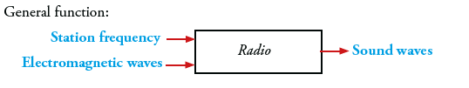

Partial function application
Some “partially applicable” devices
A partially applicable function is a function that given its first argument returns a new, more specialised, function. If you supply this new function with an argument, you get the final result.
This is what is meant by partial function application: you don’t have to pass all the arguments to a function at once

Slide 12




Partial function application returns a function
Function type
Integer -> (Integer -> Integer)

Slide 13
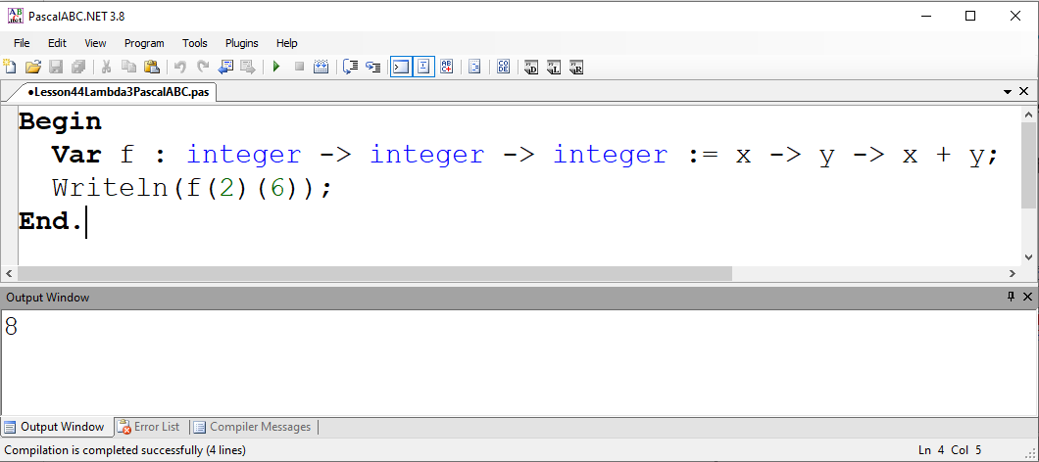
PascalABC.NET example of partial function application
Variable f is assigned a first-class anonymous function that takes two arguments x and y and returns x + y.
Partial function f(2) is a specialised function which takes a single argument and returns a new function which adds 2 to y, i.e. returns 2 + y.
Input
Output
For example, we can apply the partial function f(2) to argument 6, i.e. call f(2)(6) and get 8 returned:
First class functions can
appear in expressions
be assigned to a variable
Be passed as an argument to another function
Be returned as the result of a function call

Slide 14
Delphi example of partial function application
Program DelphiAdd2Project;
{$APPTYPE CONSOLE}
{$R *.res}
Uses
System.SysUtils;
Type
TFunctionOfInteger = Reference To Function(Parameter : Integer) : Integer;
Function f(x : Integer) : TFunctionOfInteger;
Begin
Result := Function(y : Integer) : Integer
Begin
Result := x + y;
End;
End;
Begin
Writeln(f(2)(6));
Readln;
End.
TFunc is a reference to a generic function
Object
Could use TFunc<Integer, Integer>
x
2
FFunc
In computer science, a closure is a first-class function with free variables that are bound in the
lexical environment, i.e. a closure captures variables from its surrounding scope at define-time and is able to use these variables at execution time even if these variables are no longer in scope, i.e. closures preserve the outer scope inside an inner scope. Closures only make a function impure if you modify the closed-over variable.

Slide 15
Can use functional programming style in OOP to gain benefits of FP
Can use functional programming style in OOP to gain benefits of FP:
Testability because the result returned by a pure function depends only upon the arguments passed into it, and because the function generates no side-effects, automated tests are easier to write and more effective.
Provability. If functions A and B are pure, side-effect free functions, and both A and B are correct, then any combination of A and B is also correct. This is not true when combining functions and methods that do not adopt this pure approach.
Parallelism. Functionality written using the pure FP approach is much easier to parallelise for performance and scalability.
If the function is only used once, or a limited number of times, an anonymous function may be syntactically lighter than using a named function.
Anonymous functions are ubiquitous in functional programming languages and other languages with first-class functions.
Using pure functions simplifies parallel computing since two purely functional parts of the evaluation never interact, and a function always returns the same output, given the same input.

Slide 16
Higher-order functions
The next example explores anonymous functions/procedures in the context of higher-order functions.
A function that takes a function as an argument or returns a function as a result (or does both)
is a higher-order function.
Higher-order functions make it possible to define very general functions that are useful in a variety of applications.
Map
Our first example of a higher-order function is the map function.
This function applies a given function to each element of a list, returning a list of results.
For example, to apply the action of squaring to every element of an array of integer [1,2,3,4,5,6,7,8,9,10]
we do the following
map f [1,2,3,4,5,6,7,8,9,10]
Map(Function(x : Integer) : Integer
Begin
Result := x * x;
End, AnArrayOfInteger);
map f [1,2,3,4,5,6,7,8,9,10]
means [f 1, f 2, ..., f 10]

Slide 17
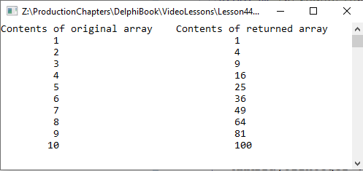
Map function that uses an anonymous function
Program IntroductionToMapProject;
{$APPTYPE CONSOLE}
{$R *.res}
Uses
System.SysUtils;
Type
TFunctionOfInteger = Reference to Function(x : Integer) : Integer;
TArrayOfInteger = Array Of Integer;
Var
AnArrayOfInteger : TArrayOfInteger = [1, 2, 3, 4, 5, 6, 7, 8, 9, 10];
AnotherArrayOfInteger : TArrayOfInteger;
Function Map(f : TFunctionOfInteger; ArrayOfInteger : TArrayOfInteger) : TArrayOfInteger;
Begin
SetLength(Result, Length(ArrayOfInteger)); {Result variable stores reference to array block of memory}
For Var i := Low(ArrayOfInteger) To High(ArrayOfInteger)
Do Result[i] := f(ArrayOfInteger[i]);
End;
Begin
AnotherArrayOfInteger := Map(Function(x : Integer) : Integer
Begin
Result := x * x;
End, AnArrayOfInteger);
Writeln('Contents of original array Contents of returned array');
For Var i := Low(AnotherArrayOfInteger) To High(AnotherArrayOfInteger)
Do Writeln(AnArrayOfInteger[i] : 10, ' ' : 30, AnotherArrayOfInteger[i]);
Readln;
End.

Slide 18
Reduce function
Reduce or fold
Reduce or fold is the name of a higher-order function which reduces a list of values to a single value by repeatedly applying a combining function to the list of values.
In the folding or reduction process, a function, e.g. sum, is applied to the list, element by element, returning something such as the total sum of all elements.
A reduce/fold takes a binary function (function of two variables), a starting value (often called an accumulator), and a list to fold up. The fold reduces the entire list down to a single accumulator value.
reduce f 0 [1,2,3,4,5,6,7,8,9,10]
Reduce(Function(x, y : Integer) : Integer
Begin
Result := x + y;
End, 0, AnArrayOfInteger);

Slide 19
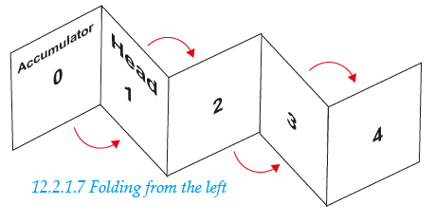

Reduce function using anonymous function
Program IntroductionToReduceProject;
{$APPTYPE CONSOLE}
{$R *.res}
Uses
System.SysUtils;
Type
TFunctionOfInteger = Reference to Function(x, y : Integer) : Integer;
TArrayOfInteger = Array Of Integer;
Var
AnArrayOfInteger : TArrayOfInteger = [1, 2, 3, 4, 5, 6, 7, 8, 9, 10];
Function Reduce(f : TFunctionOfInteger; InitialValue : Integer;
ArrayOfInteger : TArrayOfInteger) : Integer;
Begin
Result := InitialValue; {Result performs role of accumulator}
For Var i := Low(ArrayOfInteger) To High(ArrayOfInteger)
Do Result := f(ArrayOfInteger[i], Result);
End;
Begin
Var Sum := Reduce(Function(x, y : Integer) : Integer
Begin
Result := x + y;
End, 0, AnArrayOfInteger);
Writeln('Sum: ', Sum);
Readln;
End.
reduce f 0 [1,2,3,4,5,6,7,8,9,10]

Slide 20
Filter function
The filter function is a higher-order function that processes a data structure, e.g. a list, in some order to produce a new data structure containing exactly those elements of the original data structure that match a given condition.
For example, filter can apply the even function to every element of the integer list [1,2,3,4,5,6,7,8,9,10] and return a list containing integers that possess the property of evenness.
E.g
filter even [1,2,3,4,5,6,7,8,9,10]
Filter(Function (Item : Integer) : Boolean
Begin
Result := Item Mod 2 = 0; {Tests for evenness}
End, AnArrayOfInteger);

Slide 21
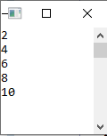
Filter function using anonymous function
Program IntroductionToFilterProject;
{$APPTYPE CONSOLE}
{$R *.res}
Uses
System.SysUtils;
Type
TFunctionOfInteger = Reference to Function(x : Integer) : Boolean;
TArrayOfInteger = Array Of Integer;
Var
AnArrayOfInteger : TArrayOfInteger = [1, 2, 3, 4, 5, 6, 7, 8, 9, 10];
AnotherArrayOfInteger : TArrayOfInteger;
Function Filter(f : TFunctionOfInteger; ArrayOfInteger : TArrayOfInteger) : TArrayOfInteger;
Var Count, NewLength : Integer;
Begin
Count := -1; NewLength := 0;
For Var i := Low(ArrayOfInteger) To High(ArrayOfInteger)
Do
If f(ArrayOfInteger[i]) {Filter operation}
Then
Begin
Inc(Count); Inc(NewLength);
SetLength(Result, NewLength);{Extends the array's length}
Result[Count] := ArrayOfInteger[i]; {Adds the item that passes the test}
End;
End;
Begin
AnotherArrayOfInteger := Filter(Function (Item : Integer) : Boolean
Begin
Result := Item Mod 2 = 0; {Tests for evenness}
End, AnArrayOfInteger);
For Var i := Low(AnotherArrayOfInteger) To High(AnotherArrayOfInteger)
Do Writeln(AnotherArrayOfInteger[i]);
Readln;
End.

Slide 22
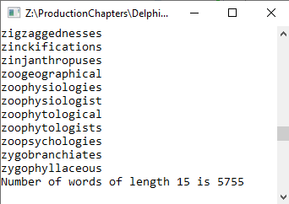
Scrabble example of use of Filter higher-order function
Program WordsProject;
{$APPTYPE CONSOLE}
{$R *.res}
Uses System.SysUtils, System.Classes;
Type
TFunctionOfString = Reference to Function(AString : String) : Boolean;
Function Filter(GivenWordList : TStringList ; f : TFunctionOfString) : TStringList;
Begin
Var FilteredNewWordList := TStringList.Create;
For Var Word In GivenWordList
Do If f(Word) Then FilteredNewWordList.Add(Word);
Result := FilteredNewWordList;
End;
Var
WordLength : Integer;
Begin
Var WordList := TStringList.Create;
WordList.LoadFromFile('../../Sowpods.txt');
Write('Input word length to filter on: ');
Readln(WordLength);
Var NewWordList := Filter(WordList, {with} Function (Word : String) : Boolean
Begin
If Word.Length = WordLength
Then Result := True
Else Result := False;
End);
If NewWordList.Count <> 0
Then
Begin
For Var Word In NewWordList Do Writeln(Word);
Writeln('Number of words of length ', WordLength, ' is ', NewWordList.Count);
End
Else Writeln('No words of length ', WordLength);
Readln;
End.
Using an anonymous function makes it very easy to change the filter criterion

Slide 23
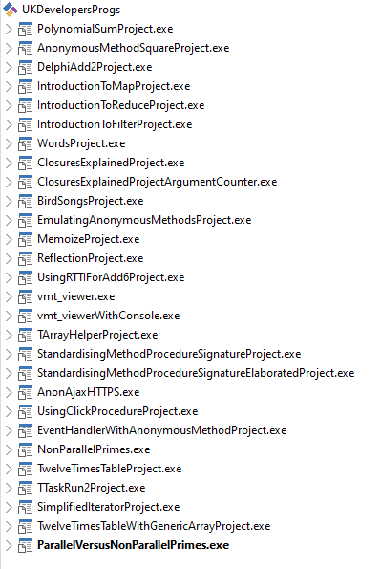
Programs used in Session 34 Delphi Boot Camp 2022
And some that there wasn’t time to demonstrate
Contact drbond@educational-computing.co.uk
To obtain a download link to the source code for these programs
Or
Use download link provided by Embarcadero at LearnDelphi.org.

Slide 24
Exploiting parallelism using an anonymous procedure
Const
UpperInteger = 10000000;
Begin
Try
// counts the prime numbers below a given value using a single thread
Total := 0;
StopWatch :=TStopWatch.Create;
StopWatch.Start;
For Var i : Int64 := 2 To UpperInteger
Do
If IsPrime(i)
Then Total := Total + 1;
StopWatch.Stop;
Writeln(Format('Non-parallel For loop. Time (in milliseconds): %d - Primes found: %d', [StopWatch.ElapsedMilliseconds,Total]));
// counts the prime numbers below a given value using parallelisation of loop
Total := 0;
StopWatch :=TStopWatch.Create;
StopWatch.Start;
TParallel.For(2, UpperInteger, Procedure(i : Int64)
Begin
If IsPrime(i)
Then TInterlocked.Increment(Total);
End);
StopWatch.Stop;
Writeln(Format('Parallel For loop. Time (in milliseconds): %d - Primes found: %d', [StopWatch.ElapsedMilliseconds,Total]));
Readln;
Except On E : EAggregateException
Do Writeln(E.ToString);
End;
End.
Function IsPrime(n : Int64) : Boolean;
Begin
Var k : Int64 := Trunc(Sqrt(n));
Var i : Int64 := 2;
While (i <= k) And ((n Mod i) <> 0)
Do Inc(i);
Result := i > k;
End;
Simplifies parallel computing since two purely functional parts of the evaluation never interact, and a function always returns the same output, given the same input.
Multiple threads: Each thread tests a different part of the range 2..10000000. Lost update problem avoided by locking variable Total in order to enable exclusive access when updating.

Slide 25
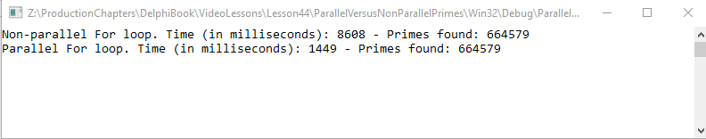
Exploiting parallelism using an anonymous procedure
AMD Ryzen 5 3600 6-core processor
Console output
Console output shows that the non-parallel solution takes roughly six times longer to execute than the parallel solution.

Slide 26
Putting together a fluent interface support unit
Unit TArrayHelperUnit;
Interface
Uses
System.SysUtils,
Math, System.Generics.Collections;
Type
TArrayHelper = Record Helper For TArray<Double>
Strict Private
Type
TForEachRef = Reference To Procedure(Var x : Double);
TMapRef = TFunc<Double, Double>;
TFilterRef = TFunc<Double, Integer, Boolean>;
TPredicateRef = TFunc<Double, Boolean>;
TReduceRef = TFunc<Double, Double, Boolean>;
Public
Function ToString : String;
Procedure ForEach(Lambda : TForEachRef);
Function Map(Lambda : TMapRef) : TArray<Double>;
Function Filter(Lambda : TFilterRef) : TArray<Double>;
Function Every(Lambda : TPredicateRef) : Boolean;
Function Some(Lambda : TPredicateRef) : Boolean;
Function Reduce(Lambda : TReduceRef) : Double; Overload;
Function Reduce(Init : Double; Lambda : TReduceRef) : Double; Overload;
End;
Implementation
……………
End.

Slide 27
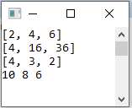
Putting together a fluent interface
Program TArrayHelperProject;
{$APPTYPE CONSOLE}
{$R *.res}
Uses TArrayHelperUnit in 'TArrayHelperUnit.pas';
Var
DbleArr1 : TArray<Double> = [1, 2, 3];
DbleArr2 : TArray<Double> = [5, 4, 3, 2, 1];
MiddleValuessOfADoubleArray : TArray<Double>;
Begin
DbleArr1.ForEach(Procedure(Var ValueInArray : Double) Begin ValueInArray := ValueInArray * 2 End);
Writeln(DbleArr1.ToString);
Var NewDbleArray := DbleArr1.Map(Function(ValueInArray : Double) : Double
Begin Result := ValueInArray * ValueInArray End);
Writeln(NewDbleArray.ToString);
MiddleValuesOfADoubleArray := DbleArr2.Filter(Function(ValueInArray : Double; i : Integer) : Boolean
Begin Result := (ValueInArray > 1) And (ValueInArray < 5) End);
Writeln(MiddleValuesOfADoubleArray.ToString);
DbleArr2.Map(Function(ValueInArray : Double) : Double
Begin
Result := ValueInArray + 5;
End).Filter(Function(ValueInArray : Double; Index : Integer) : Boolean
Begin
Result := (Index Mod 2) = 0;
End).ForEach(Procedure(Var ValueInArray : Double)
Begin Write(ValueInArray : 2 : 0) End);
Readln;
End.
Using closures and higher-order functions in Delphi (habr.com)
Use To Google Translate in Firefox
https://sudonull.com/post/103897-Using-Anonymous-Methods-in-Delphi
English translation
DbleArr1.Map(\ValueInArray -> ValueInArray * ValueInArray)

Slide 28
Type
TFunctionOfInteger = Reference To Function(Value : Integer): Integer;
//Compiler generates an interface TFunctionOfInteger with a single method Invoke with same signature as function
//An interface is a class with no implementation,
//E.g. TFunctionOfInteger = Interface Function Invoke(Value : Integer) : Integer; End;
Begin
Var Square : TFunctionOfInteger := Function(x : Integer) : Integer
Begin
Result := x * x;
End;
Writeln(Square(6)); {Function application}
Type
TIntFunc = Function(Value : Integer): Integer; // Function pointer type
TFunctionOfInteger$ActRec = Class(TInterfacedObject, TFunctionOfInteger)
Private
FFunc : TIntFunc; //Function pointer
Function Invoke(Value : Integer) : Integer;
Public
Constructor Create(AFunc : TIntFunc);
End;
Constructor TFunctionOfInteger$ActRec.Create(AFunc : TIntFunc);
Begin
FFunc:= AFunc;
End;
Function TFunctionOfInteger$ActRec.Invoke(Value : Integer) : Integer;
Begin
Result:= FFunc(Value);
End;
When Square(6) is encountered, class TFunctionOfInteger$ActRec
is created and its constructor called which creates an object with a single method Invoke with same signature as the anonymous function assigned to Square. Invoke is then called with argument 6. Invoke then calls the anonymous function assigned to Square, passing it argument 6.
AnonMethodObjectReference := TFunctionOfInteger$ActRec.Create(Square);
AnonMethodObjectReference.Invoke(6);

Slide 29
SOLID Principles of Object-Oriented Design
S: Single responsibility principle.
O: Open–closed principle.
L: Liskov substitution principle.
I: Interface segregation principle.
D: Dependency inversion principle.
Single Responsibility Principle: Every class, module, or function in a program should have one responsibility/purpose in a program. Or "every class should have only one reason to change".
Interface Segregation Principle: The interface of a program should be split in a way that the user/client would only have access to the necessary methods related to their needs.
Combining these two principles in extremis then
Every interface should have only one method.
An interface with only one method is just a function type.
E.g.
TFunctionOfInteger = Reference To Function(Value : Integer): Integer;

Slide 30
A bit of theory
What is a function?
What is meant by function type?
What is meant by function application?
What is meant by a first class object?
What is meant by partial function application?
What is Lambda calculus?

Slide 31
Function
Loosely speaking, a function is a rule that,
for each element in some set A of inputs,
assigns an output chosen from set B but without necessarily using every member of B.
For example, the function f
f : {0,1,2,3} → {0,1,2,3,4,5,6,7,8,9}
maps 0 to 0, 1 to 1, 2 to 4 and 3 to 9 when the rule is:
output the square of the input.
{0,1,2,3} corresponds to set A.
{0,1,2,3,4,5,6,7,8,9} corresponds to set B.

Slide 32
Function type
Just as data values (e.g. 6, 9.1, True) have types (integer, real, Boolean respectively) so do functions.
Function types are important because they state what type of argument a function requires and what type of result it will return.
A function f which takes an argument of type A and returns a result of type B has a function type which is written
A → B
To state that f has this type, we write
f : A → B
If f : A → B is a function from A to B we call the set A, the domain of f, and the set B the co-domain of f.
A -> B is a function type. The function f has the function type A -> B or type signature A -> B

Slide 33
Function type
For example,
squareroot : real → real
square : integer → integer
The function named squareroot applied to an argument of data type real, produces a result of data type real,
e.g.
squareroot (4.0) → 2.0

Slide 34
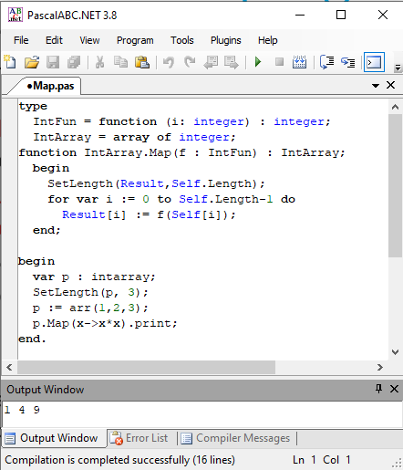
Functional programming paradigm
An anonymous function that squares its input is written in Haskell as
(\x -> x*x)
To apply this function to a list of numbers [1, 2, 3] we can use the built-in map function of Haskell in the following function composition
map (\x -> x*x) [1,2,3]
PascalABC.NET is an imperative, procedural and object-oriented language that also supports programming in a functional programming style using LINQ
Fluent interface - method chaining
Under the hood though, all LINQ queries are translated into a set of query expressions. These typically involve a heavy use of lambda expressions and closures.
Garbage collection is considered essential to functional programming – PascalABC.Net as its name suggests relies on .NET. Pure FP uses a lot of recursive data structures which would soon exhaust the stack so under the hood it is necessary to make use of the heap. Using the heap means some form of memory management is required to grab and release the allocated memory. Memory management becomes very complex so the use of a memory management system that guards against cycles etc is very helpful.
Using a functional approach in PascalABC.Net

